Slide 1
AutoGuardian: Smart Vehicle Anti-Theft System
Nkosiyabo Mdladla • CPUT • Presentation

Slide 2
Problem Statement
South Africa has one of the highest vehicle theft rates globally.
Existing solutions are either too expensive or reactive rather than proactive.
Need for a smart, real-time, affordable anti-theft system that prevents theft before it happens.

Slide 3
The Solution – AutoGuardian
AutoGuardian is a smart, real-time vehicle anti-theft system that detects
Suspicious activity and enables remote intervention through a mobile app.

Slide 4
Key Features
Smart Immobilizer / Instant Kill-Switch
GSM/GPS Real-Time Tracking
Mobile App Alerts & Controls
Remote Disable & Logging

Slide 5
System Architecture
Microcontroller → Sensors → GSM Module → Mobile App → User

Slide 6
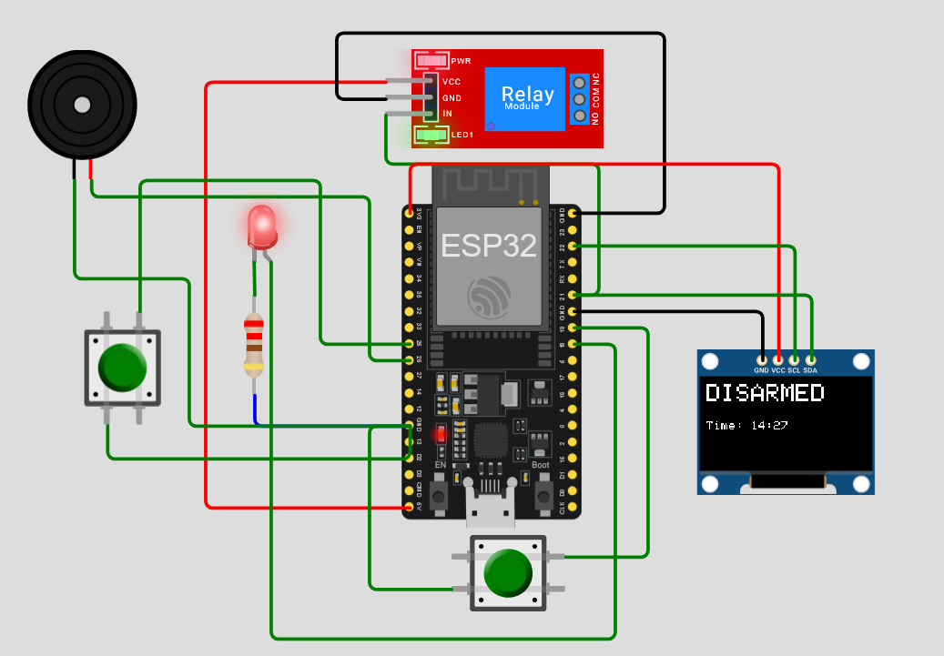
Prototype & Demo
Wokwi simulation

Slide 7
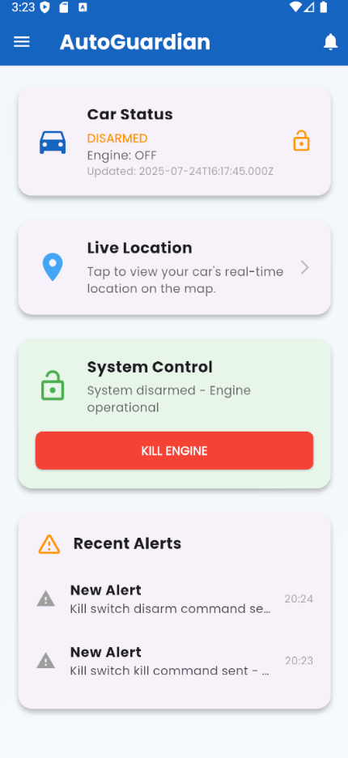
Mobile App Home Page

Slide 8
Market Opportunity
Civilian vehicle owners
Fleet operators (taxis, logistics, etc.)
Insurance companies
Affordable and scalable product

Slide 9
Estimated Hardware Cost
Microcontroller (ESP32): R200 – R250
GPS Module: R260
Relay Module: R140
GSM Module with Antenna: R300 – R400
Sensors (motion/tilt): R150 – R250
Step down Module: R340 – R400
Total per unit estimate: ±R1600 – R2000

Slide 10
Support Requested from CPUT
Prototype hardware funding
Access to labs and mentorship
Possible incubation under tech transfer

Slide 11
Conclusion
AutoGuardian has the potential to significantly reduce vehicle theft in South Africa.
With CPUT's support, prototype production and testing can begin immediately.

